Slide 1
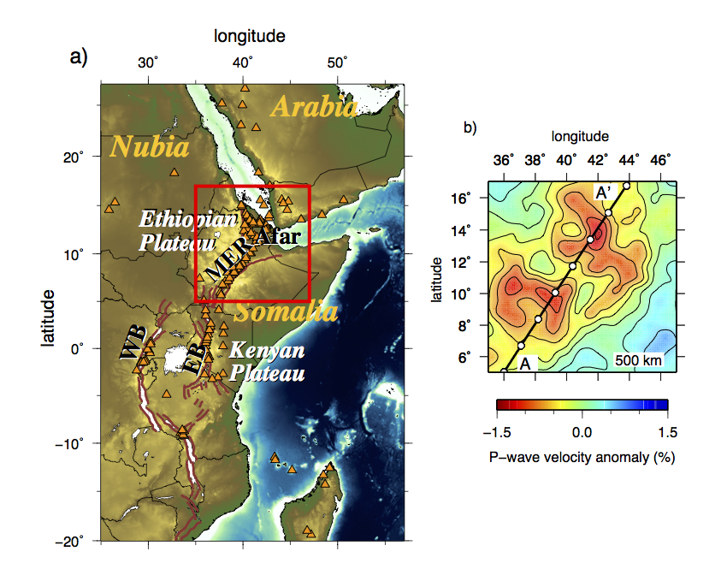
Fig. 1

Slide 2
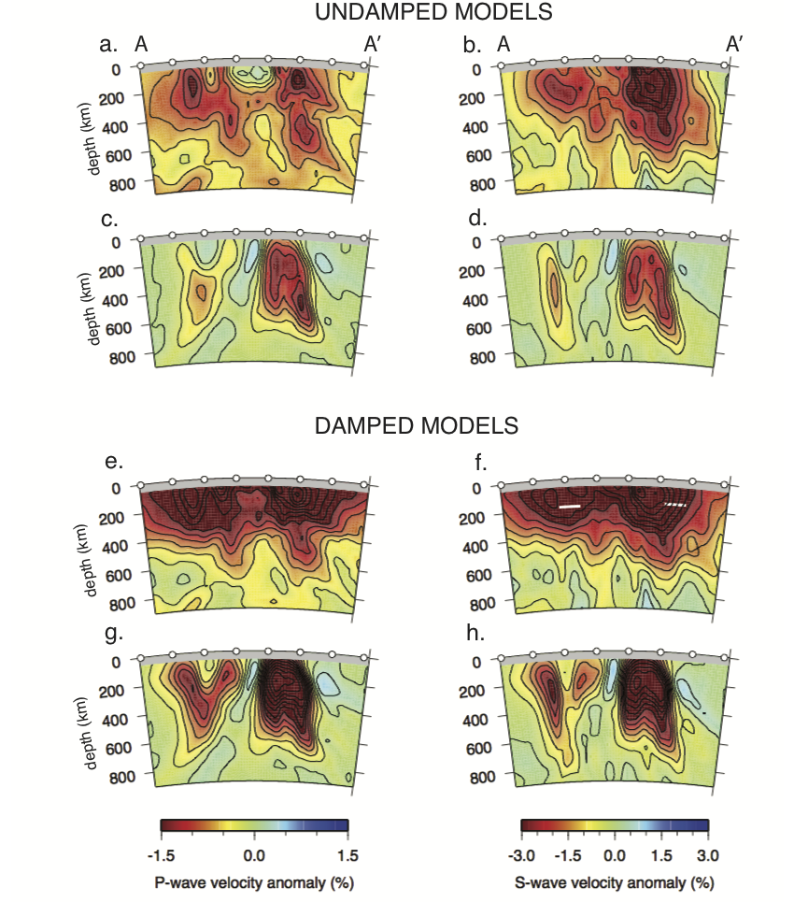
Fig. 2
Tomography
Plumelet Model
Notes:
Complex low velocity structures below Afar-MER, similar in character as synthetic modelsof plumelets derived from a hot layer near the base of the transition zone.
<number>

Slide 3
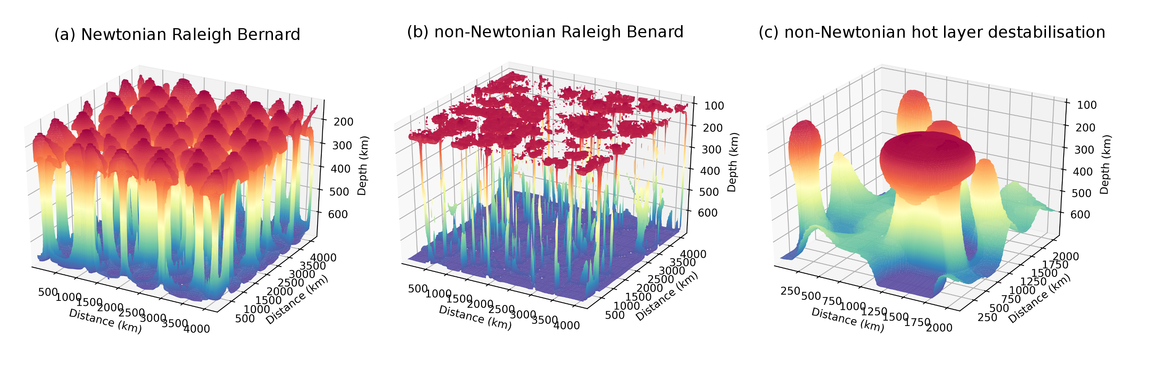
Surface plots of the 1% thermal anomaly (corresponding to a temperature of 1363.5°C if the background temperature is 1350°C) coloured by depth. In all three models the Ra = 6x10⁶. (a) Raleigh Benard convection for a Newtonian rheology showing equally spaced plumes that developed uniformly in time. The model aspect ratio is 6x6x1. (b) Raleigh Benard convection for a non-Newtonian rheology. In this case the strain rate dependence creates thin plumes with flat heads that rapidly impinge on the lithosphere. The model aspect ratio is 6x6x1. (c) Destabilisation of a 100 km thick hot layer in a non-Newtonian fluid. In this case there is a clear difference in the stages of plume formation. The model aspect ratio is 3x3x1.
Notes:
Point: A three plot comparison of the Rayleigh Benard (RB) convection for the Newtonian Arrhenius rheolgy, the equivalent non-Newtonian version, and our preferred hot layer destabilsiation model. In all of these models the Ra is the same, the hot base/hot layer temperature is the same. From this you can see that for the RB we get a field of mushrooms that are all similar, while for the destabilisation there is a time dependence. You can also see that non-Newtonian RB is no good, as the plume tails are so very thin.
<number>

Slide 4
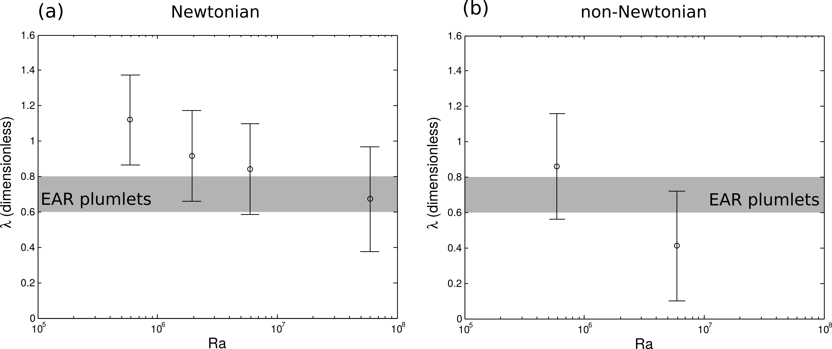
Dimensionless wavelength for Rayleigh Benard convection as a function of Raleigh number. (a) Newtonian models, showing the classic power law dependence between wavelength and Ra. The grey shaded area shows the estimate for the wavelength of the slow Vs anomalies below EAR, made dimensionless by dividing by the depth to the 660 discontinuity. If these instabilities are due to Raleigh Benard convection, we would require a low viscosity (high Ra). (b) Non-Newtonain models, showing a stronger dependence on Ra. However in this case at Ra>10⁷, the plumes become difficult to detect given the plume tails are very thin. If the upper mantle is dominantly non-Newtonian, EAR plumlets are consistent with a higher viscosity (lower Ra)
Notes:
Two plots of wavelength vs. Ra. The wavelength is made dimensional by the depth of the box. I put in a guestimate for the wavelength of our observed low Vs zones, ~500km / 700km = 0.7. We can see that if the mantle is dominated by diffusion creep, and what we are seeing are plumes, we need a high Ra (low viscosity), but if dislocation creep dominates, the viscosity can be higher.
<number>

Slide 5
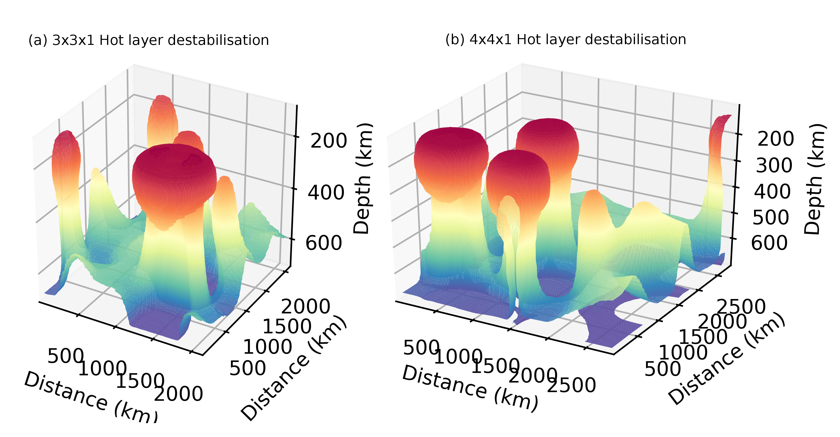
Comparison of patterns of destabilisation of a 100°C hot layer for a 3x3x1 and 4x4x1 Cartesian box.
Notes:
Two surface plots from or hot layer destabilising. (a) for the 3x3x1 100°C model and (b) 4x4x1 100°C model. Here we can see how the distribution changes (not so much) for the change in aspect ratio. However, the bigger box means we have three plumelets at a similar stage in evolution. The smaller box limits that to one.
<number>

Slide 6
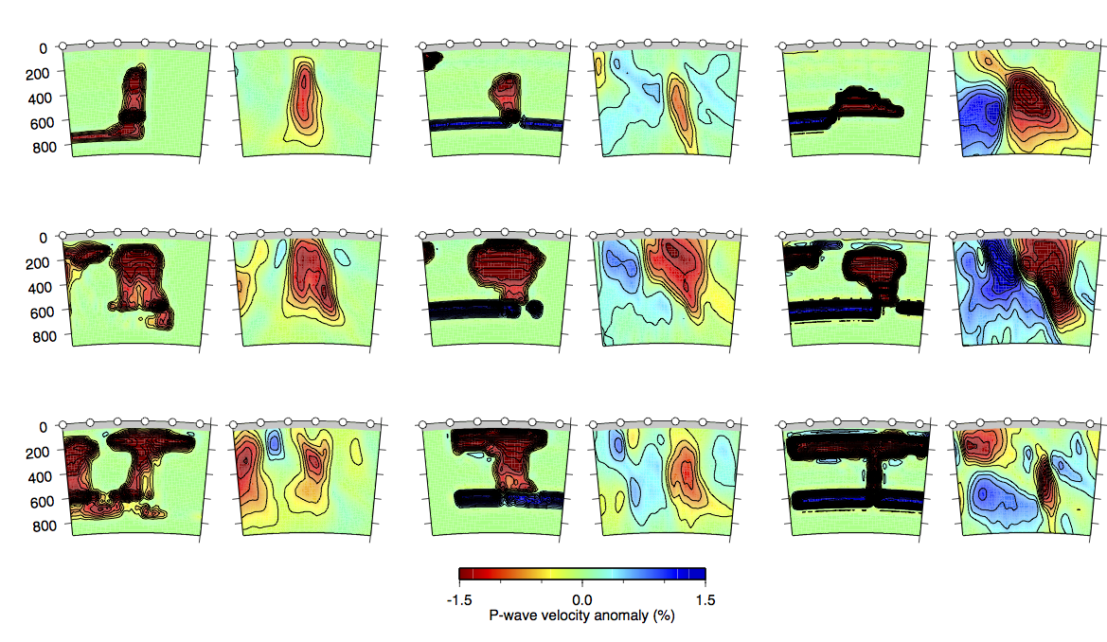
P- undamped
100 K
200 K
400 K
EP
MP
LP
S- waves and damped versions in the Supplementary
Notes:
Nice figure. However need to include depth envelopes to convincingly make the point about amplitudes in the transition zone.
<number>

Slide 7
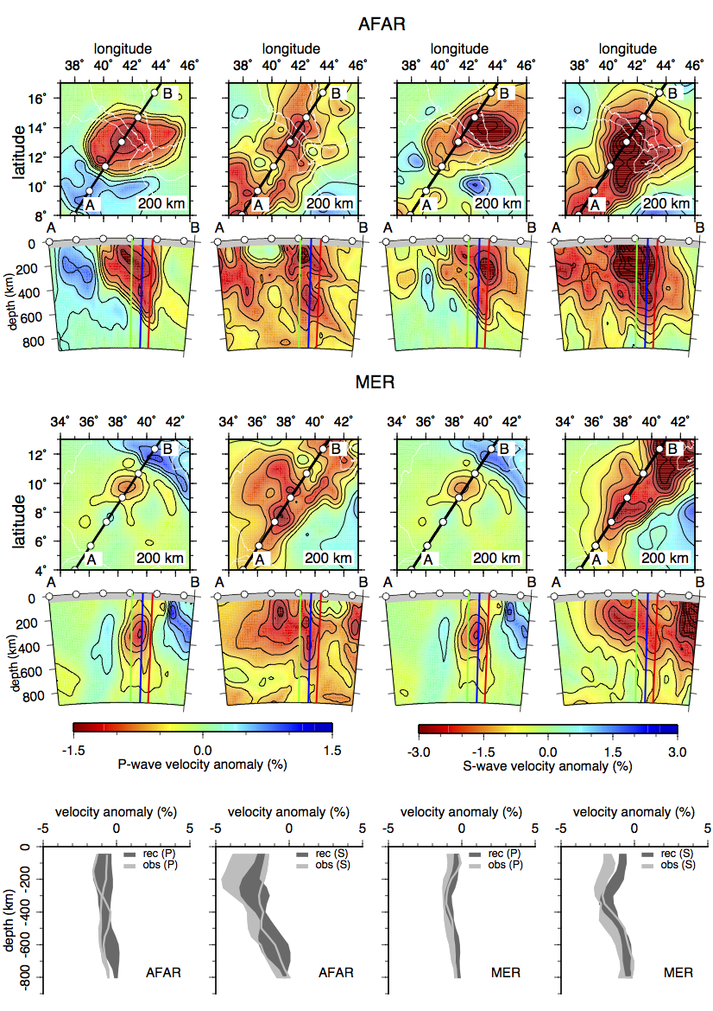
200K model
P-waves & S-waves
Undamped
AFAR > MP
MER > LP
Damped version in the Supplementary

Slide 8
Suggestion instead of Fig 6
Figure 6 is very nice but may jump to a summary of the results too quickly to convince the reader. I suggest to instead start with something like the info in the two following slides. Not at all necessary to keep format of the slides. You can probably use modifications of the scripts for your nice figure to make something better than my quickly patched together slide
(I) Suggest to first show how different stage plumes for single DT (200K) work for Vp structure below Afar and MER separately to make point about in what depth range anomalies are required. This should include depth envelopes to be more quantitative. Should illustrate that anomalies required through transition zone, with source layer below 660, and need thinned/melt modified lithosphere above plume to explain strong and laterally localised shallow anomalies.
(II) Then can follow with figure that illustrates that DT=100K is too low and DT=400K too high for the favoured plumes from (I), again including depth envelopes.
(III) Then can use your Fig 7 to illustrate that same structures from (I) can also match Vs.

Slide 9
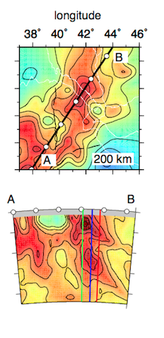
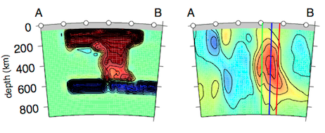
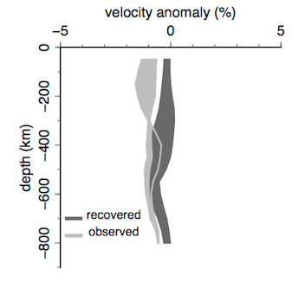
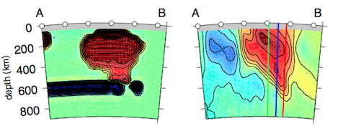
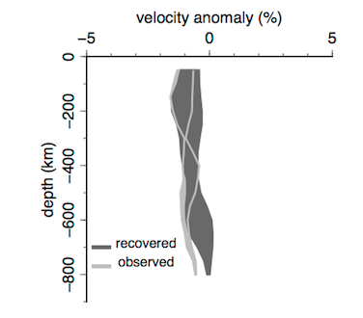
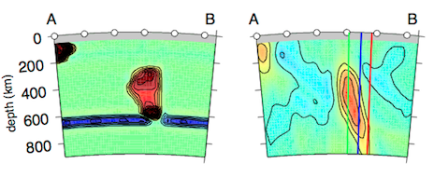
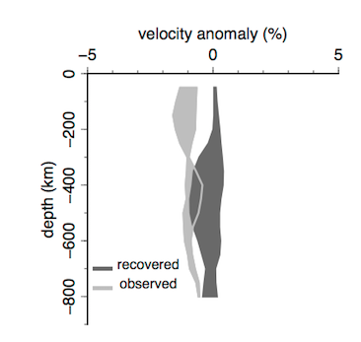
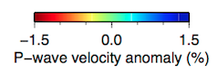
Undamped – P - Afar
Notes:
AFAR: Need significant anomaly shallow, and late-stage spread plume head would not show in undamped tomo
More laterally confined plume head, intermediate stage, works (under thin lithosphere), but this model does not have structure quite deep enough
Early stage plume too weak at most depth levels
<number>

Slide 10
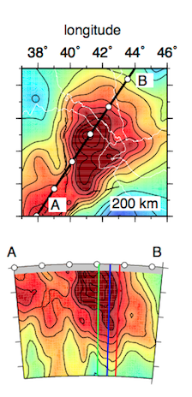
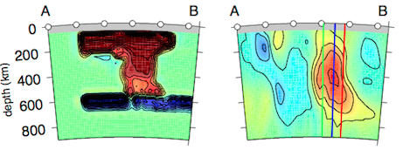
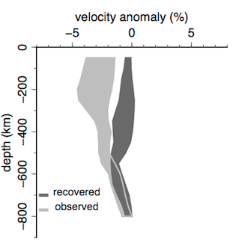
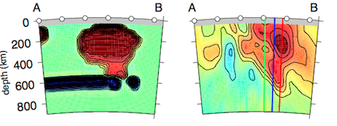
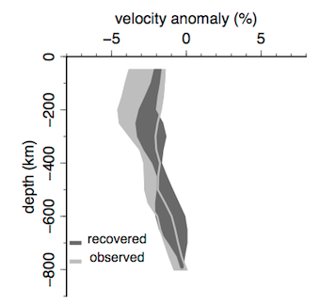
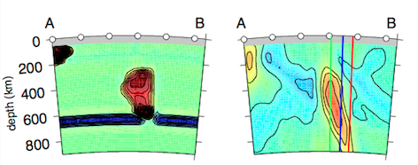
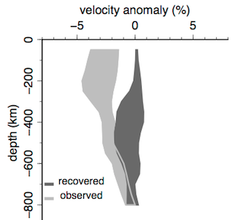
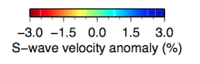
Undamped – S - Afar
Notes:
Conclusions from S similar as from P, but more amplitude mismatch, which may indicate a contribution of melt/fluids
<number>

Slide 11
Correlation analysis?
Does correlation-depth analysis make likely depth of source layer any more convincing than cross sections through different models?

Slide 12
dlnVs/dlnVp analysis?
I thought these synthetic tests from the thesis did provide a good word of caution on using R, but is this a bit too much for the paper, which will be relatively long already?

